Slide 1
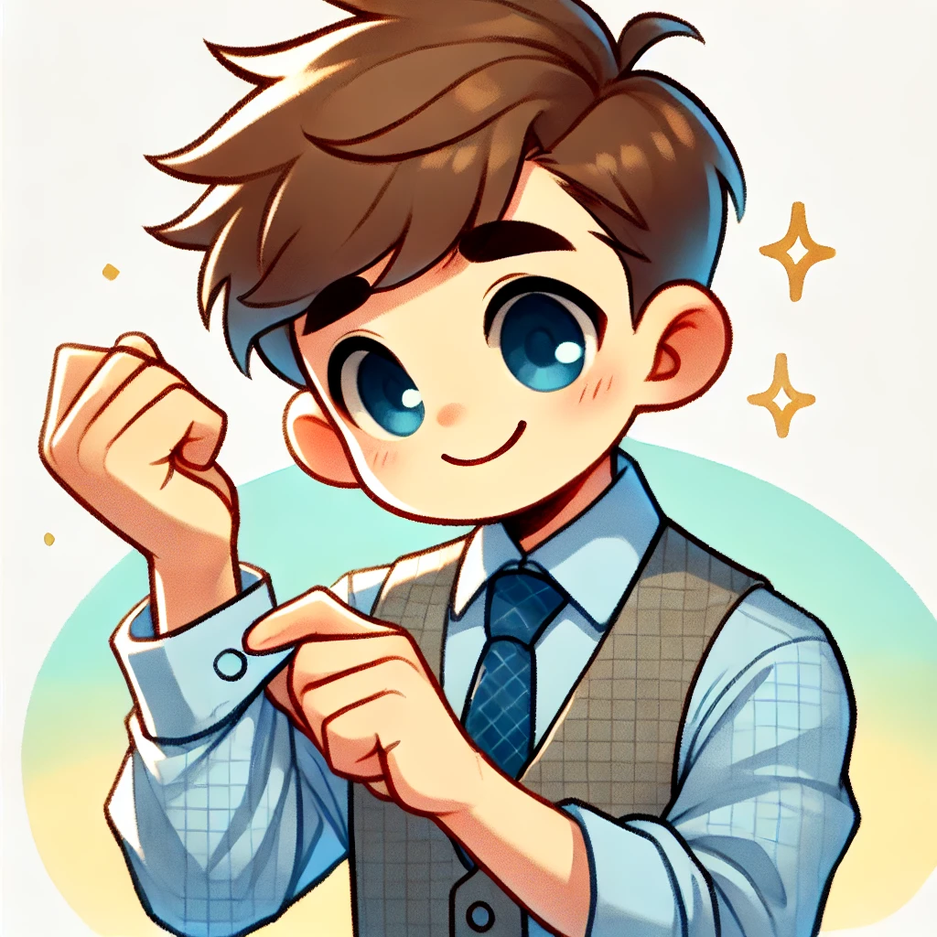
The cuff is blue.

Slide 2
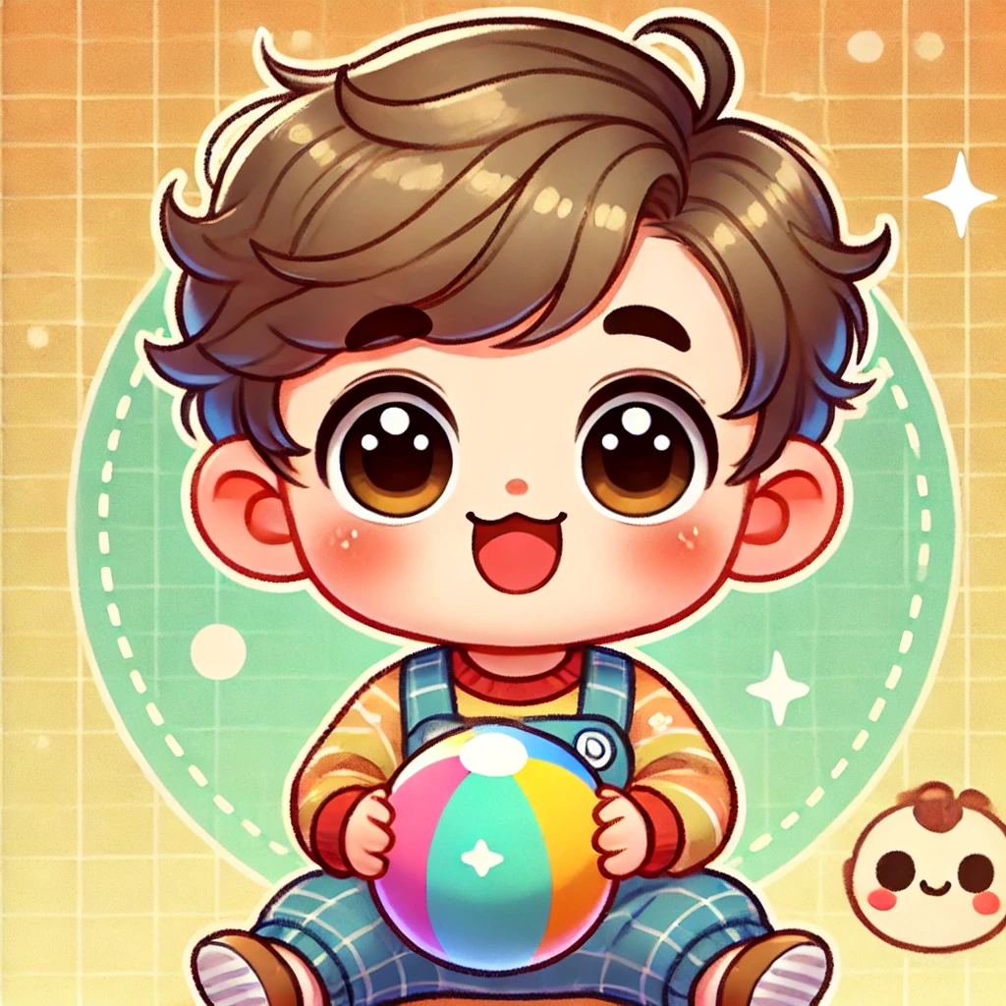
I have a ball.

Slide 3

The moss is green.

Slide 4
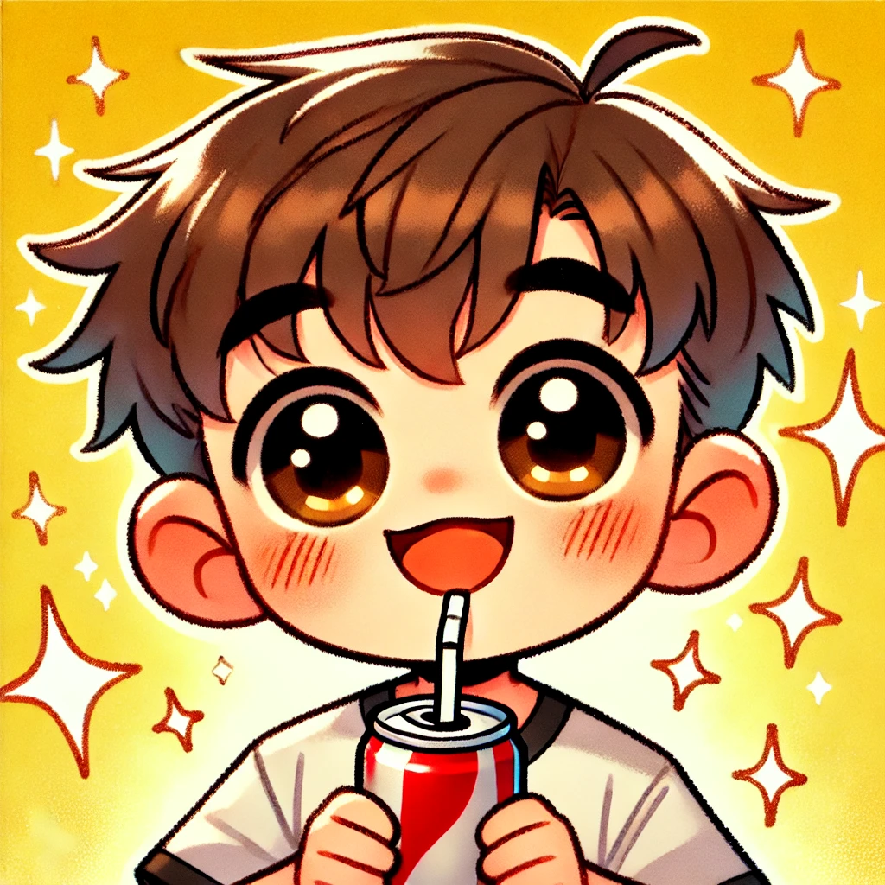
The soda has fizz.

Slide 5

The egg is big.

Slide 6
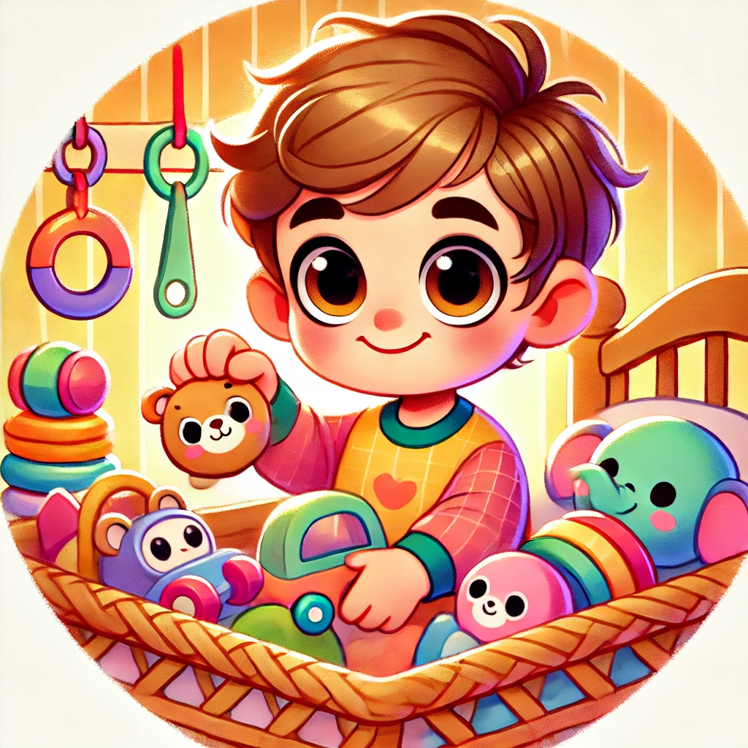
Add one more toy.

Slide 7
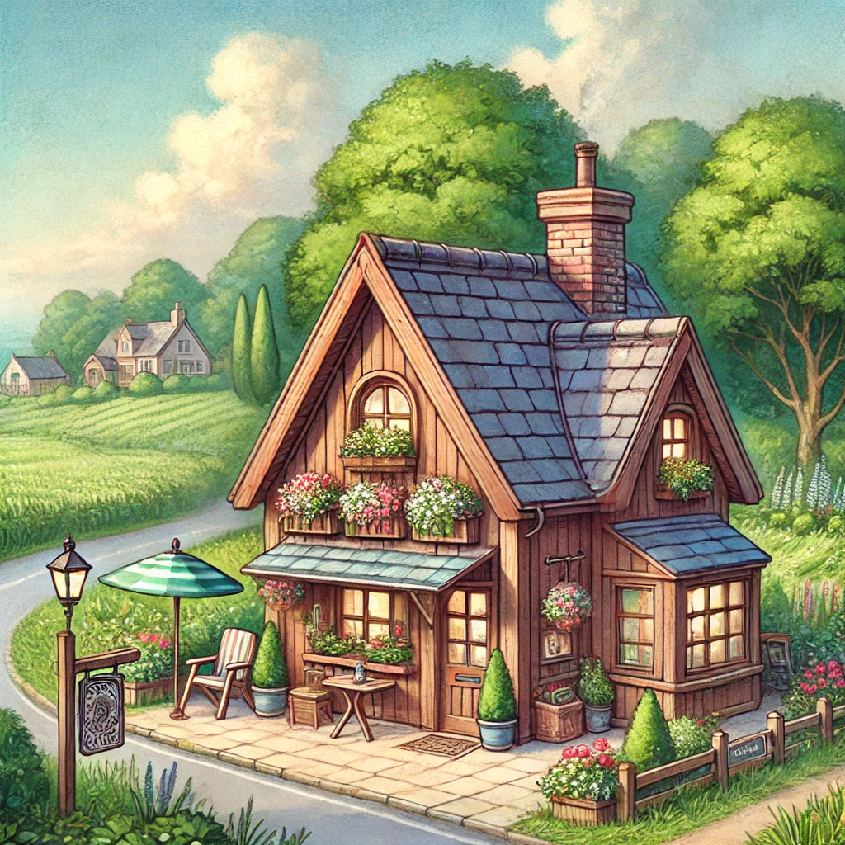
The inn is small.

Slide 8

I like this app.

Slide 9
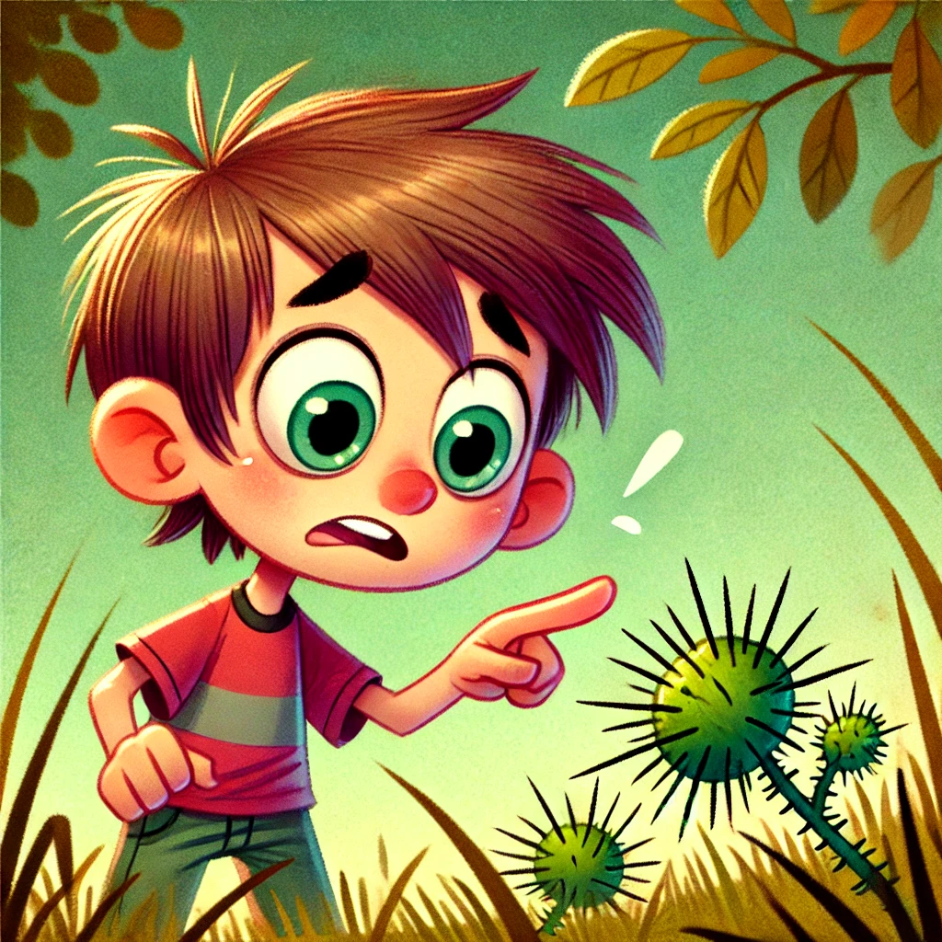
The burr is sharp.

Slide 10
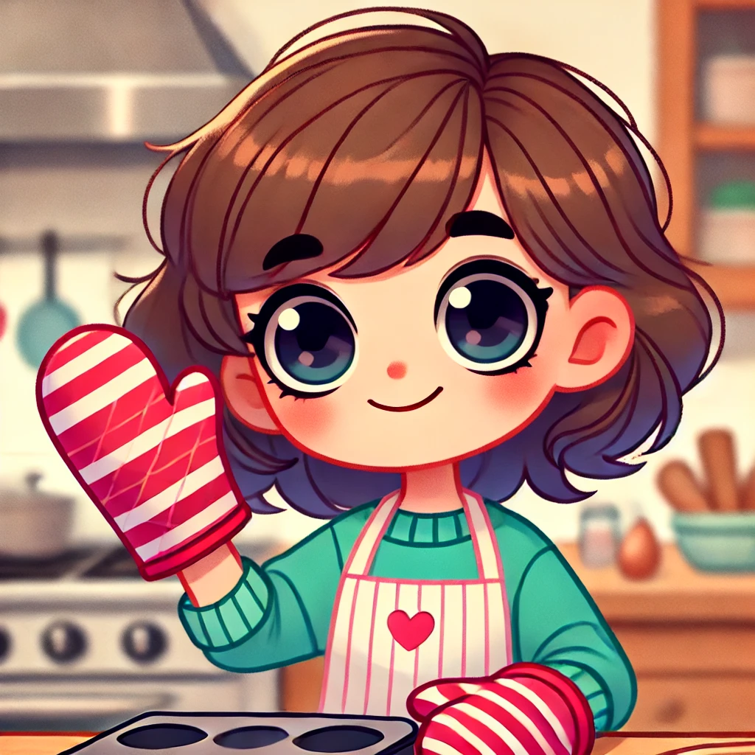
The mitt is soft.

